Slide 1
Virtual Machine Setup

Slide 2
Requirements
Hard Disk: ~25GB free space in (C:/ Drive in Windows; /home in macOS)
RAM: ≥ 4GB
Internet connection

Slide 3
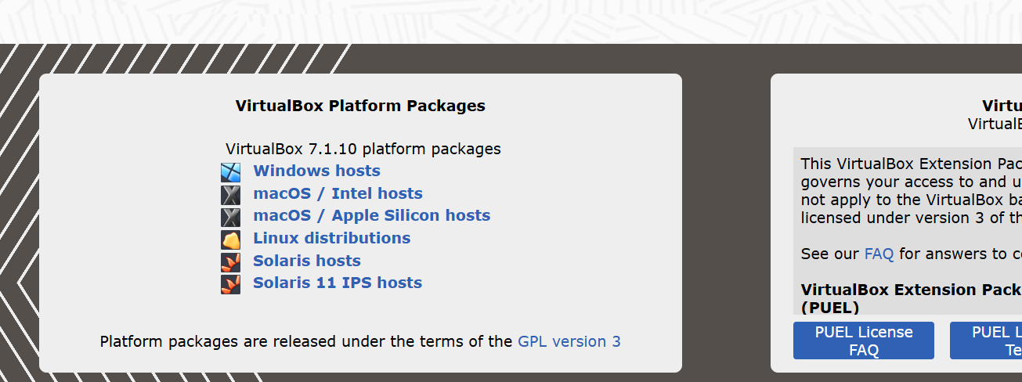
Install VirtualBox
Visit https://www.virtualbox.org/wiki/Downloads
Download and install appropriate version based on your laptop.
For windows laptop
For old macs (intel/x86 processor)
For new macs (ARM processor)
M1,M2,M3,M4
For linux (Ubuntu, Debian, etc)

Slide 4
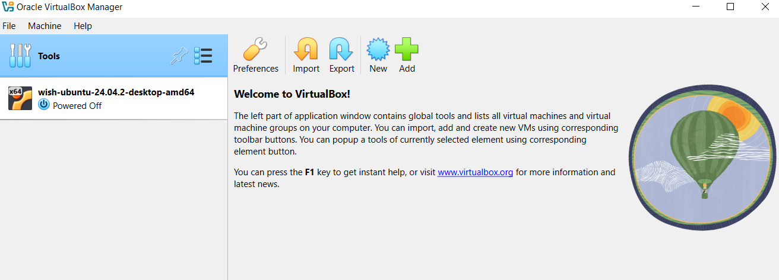
Download and load image
Download one of the image from google drive based on your laptop.
Link: ??
For Intel/AMD/x86 processors: amd64-wish-ubuntu-24.04.2-desktop.ova (~5 GB)
For ARM processors: arm64-wish-ubuntu-24.04.2-desktop.ova (~5 GB)
Open VirtualBox
Click on “Import”

Slide 5
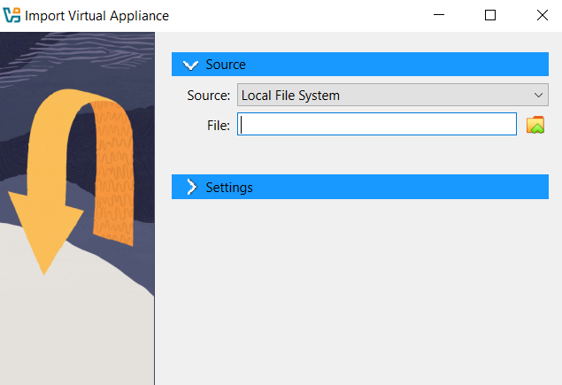
Download and load image
Select the downloaded image file
Click on “Finish”

Slide 6
Download and load image
Once the image is loaded successfully, it will appear in your VirtualBox
Double click on the image to start it.

Slide 7
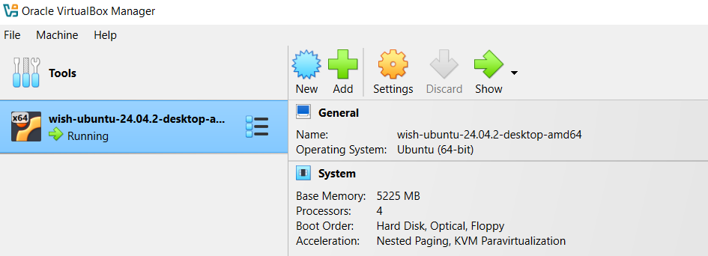
Configuring the image
Select the image and click on “Settings” (make sure the image is powered off)

Slide 8
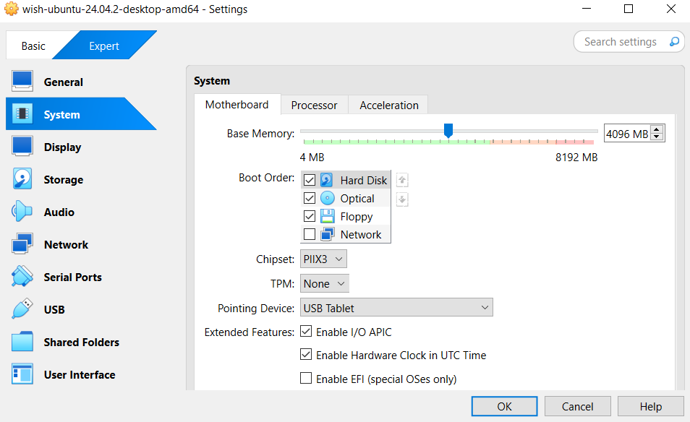
Configuring the image
Click on “System” and drag the slider to adjust RAM allocation to the image (according to your pc specifications). Try to allocate >2GB.

Slide 9
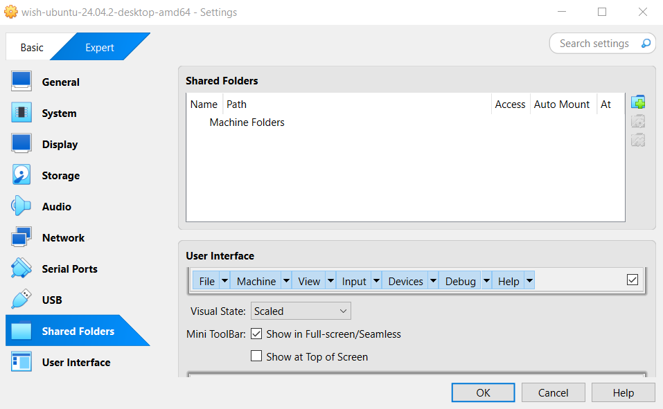
Configuring the image
Adding a shared folder helps us transfer files between host machine (your laptop) and the Virtual Machine.
Click on “Shared Folders” and then “Add new shared folder”.
Add new shared folder

Slide 10
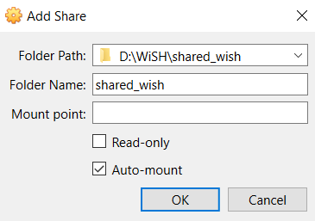
Configuring the image
Create a new folder in your laptop somewhere.
Select “Folder Path” as that new folder location and check “Auto-mount” option.
Click on OK of Add Share window.
Click on OK of Settings window.

Slide 11
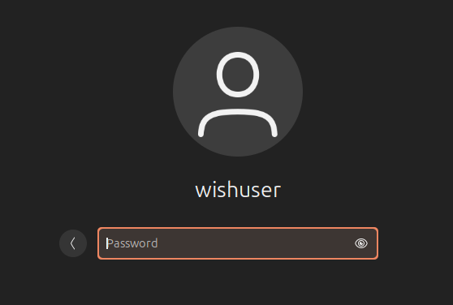
Testing the image
Start the image by double clicking on it.
Login into wishuser. Password: wish2025

Slide 12
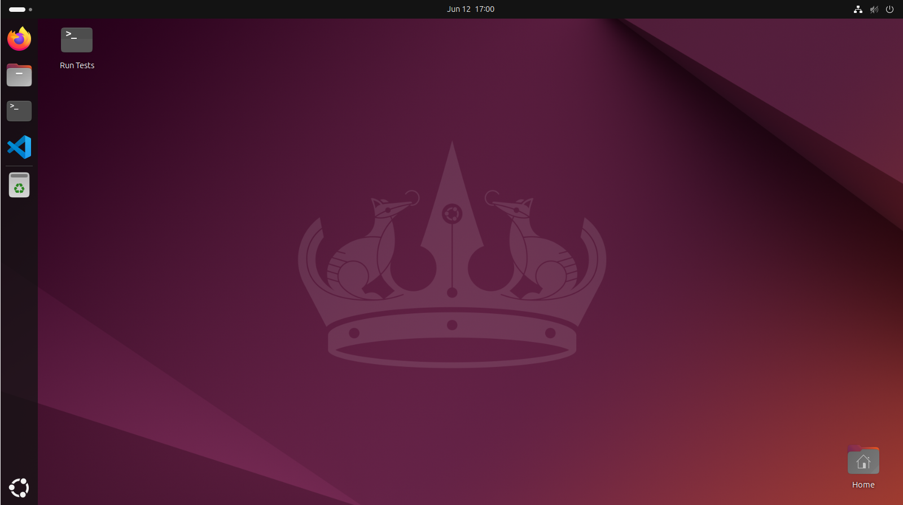
Testing the image
Double click “Run Tests” icon on desktop to run the tests.
Go through the output and check if anything is failing. It will appear as [FAIL]
BONUS: This script also displays some important commands and paths…

Slide 13
Navigating inside Ubuntu image
Open File Browser. The course files would be present in “wish25-course” folder.
Open terminal.
Enter pwd command (type pwd and press enter).
/home/wishuser should appear which is your home directory. It is also known as ~
Enter ls command to display files and folders in your current folder.
Enter cd wish25-course command to change directory (similar to double clicking a folder).
Enter cd ~ to return to home directory.
File Browser
Terminal
VS Code

Slide 14
Running a sample Verilog code
Open Terminal.
Change directory to ~/wish25-course/demo/ using
cd ~/wish25-course/demo/
Files present:
counter.sv - counter verilog file
counter_wrapper.sv - counter wrapper verilog file
tb_counter.sv - verilog testbench
test_counter.py - cocotb testbench
Makefile - to launch and simulate testbench
Makefile.verilog - to run verilog testbench
Makefile.cocotb - to run cocotb testbench

Slide 15
Running a sample Verilog code
Running verilog testbench:
Run make verilog_sim
counter_ivlog.vcd must be created which has output waveforms.
Run gtkwave counter_ivlog.vcd to view waveforms.
Running cocotb testbench:
Activate python virtual environment by running
source ~/wish_venv/bin/activate
Run make cocotb_sim
counter_cocotb.vcd must be created which has output waveforms.
Run gtkwave counter_cocotb.vcd to view waveforms.

Slide 16
Exploring more
In File Explorer, navigate to wish25-course -> tool_slides.
These slides contains important information that may be needed in future session.
That’s it, your Virtual Machine is ready to use…

